Slide 1
History – Part 2
Chapter – 10
The Changing World of Visual Arts
A great story about Colonial period of British India

Slide 2
New forms of imperial art
In 18th Century a stream of European Artists came to India along with the British traders and rulers. The artists bought with them the new styles and new conventions of paintings. These paintings became widely popular in Europe and helped shape Western perceptions of India.
European artists bought the idea of Realism with them. This means , what the artists produced was expected to look real and lifelike. They also bought the “ OIL PAINTING “ – a technique of painting which was new to Indian artists.
Also , some European traders thought differently. The subjects they painted varied , but they seemed to emphasise the superiority of Britain.

Slide 3
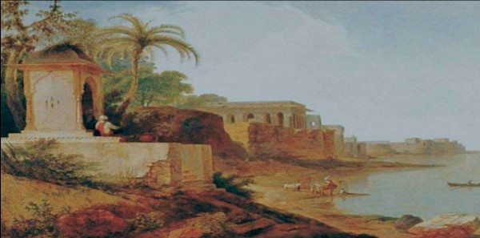
Looking for the Picturesque
Ruins on the banks of river Ganges at Ghazipur.

Slide 4
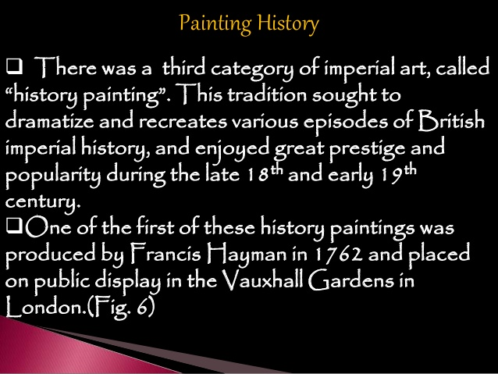

Slide 5
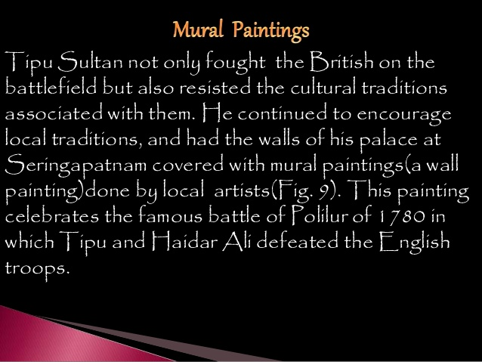

Slide 6
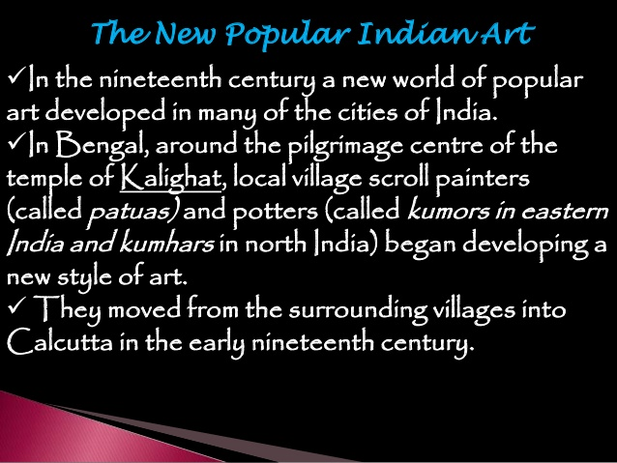

Slide 7
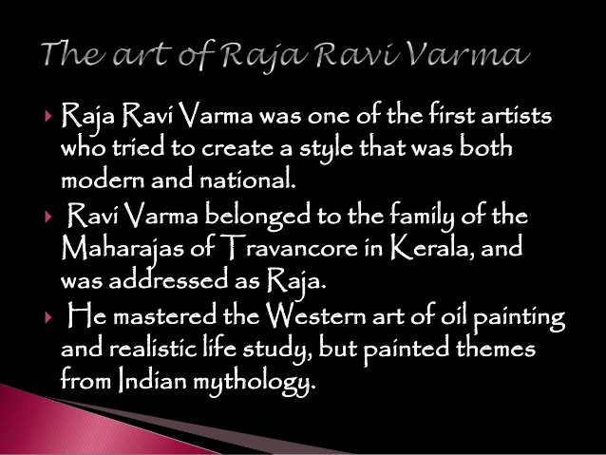

Slide 8
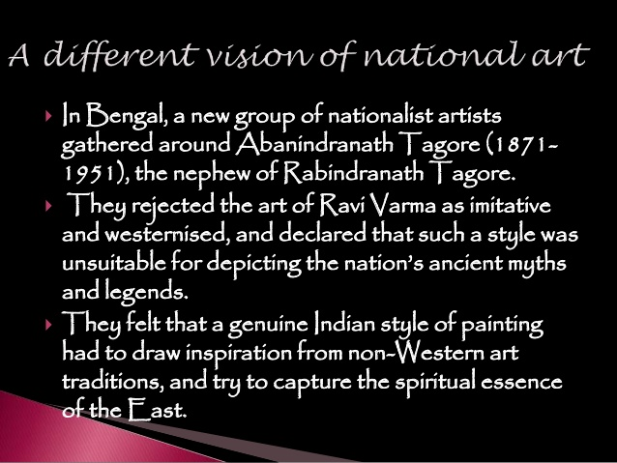

Slide 9

Created by : Nameer S. Shaikh

